Slide 1
Thermal Energy Year 11 Physics

Slide 2
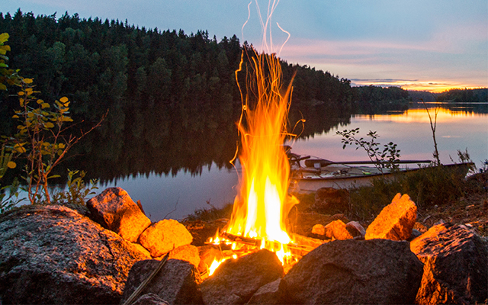
Learning Objectives
Define thermal energy
Explain the difference between heat, temperature and thermal energy
Compare the Celsius and Kelvin scales
Activate Prior Knowledge
In your own words, explain what you think heat is. Try to say where your ideas came from.

Slide 3
Concept Development
Caloric Theory
In the 18th and 19th centuries, it was believed that heat was a colorless, tasteless fluid called caloric.
Every object had a certain amount of caloric.
When caloric flowed from one object to another, it caused the second one to heat up and the first one to cool down.
Combustion (burning) released an enormous amount of caloric – as the burning object disintegrated, caloric escaped, heating up the surroundings.

Slide 4
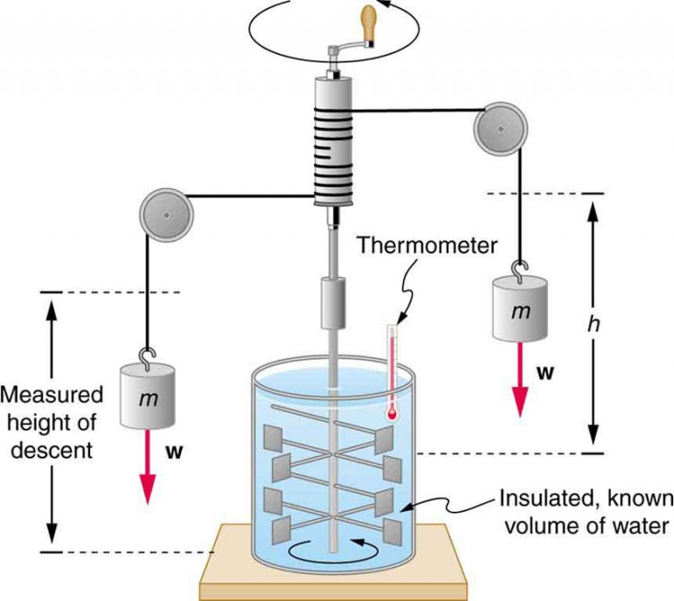
Concept Development
James Prescott Joule
In 1876, Joule set up a falling weight that caused a paddle wheel to turn. He observed that the friction between the wheel and water caused the temperature of the water to rise.
He noticed that stirring water could also cause a rise in temperature.
He concluded that the process of heating or cooling was a transfer of energy.

Slide 5
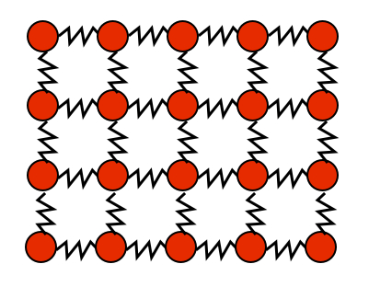
Concept Development
Kinetic Theory (a.k.a. Particle Theory)
All matter consists of tiny particles (atoms, molecules, ions).
Electrical forces, both attractive and repulsive, exist between these particles.
Particles move constantly (i.e. they all have kinetic energy) and in a random manner.
Collisions between particles involve no loss of kinetic energy (i.e. particle collisions are all perfectly elastic).
The distances between particles in a gas are large compared to the size of the particles.

Slide 6
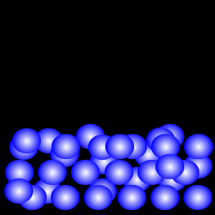
Concept Development
Thermal Energy
The thermal energy of an object is the sum of the kinetic and potential energies of all of the particles in that object.
The particles in a substance all move (by vibration, rotation and/or by travelling from place to place). Their kinetic energy determines how fast they are moving.
The particles can also attract or repel neighbouring particles, so they also have potential energy.

Slide 7
Concept Development
Temperature
Temperature measures the average kinetic energies of an object’s particles. We experience this as how hot or cold an object is.
Temperature is measured in degrees Celsius (°C).

Slide 8
Concept Development
Thermal Energy vs. Temperature
Sparks coming off a sparkler can reach up to 982 °C – hot enough to melt gold – but they have very little thermal energy and will not burn you if they land on your skin.
A beaker of water at 60 °C is hotter (temperature) than a bath of water at 40 °C, but the bath contains more thermal energy.

Slide 9
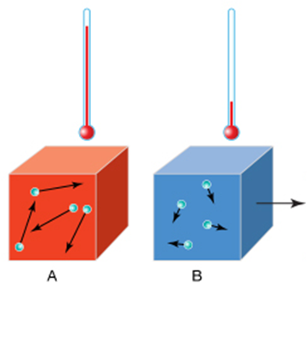
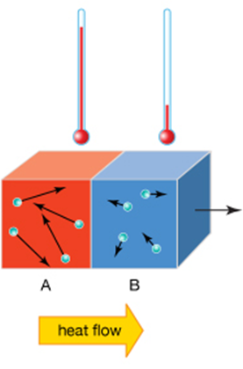
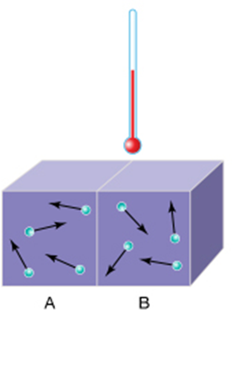
Concept Development
Heat
Heat describes thermal energy being transferred between objects because of a difference in their temperatures.
Heat is measured in Joules (J).
Heat always flows from a body at higher temperature to a body at lower temperature.
Heat transfer between the objects stops when their temperatures are equal, at which point the objects are said to be in thermal equilibrium.

Slide 10
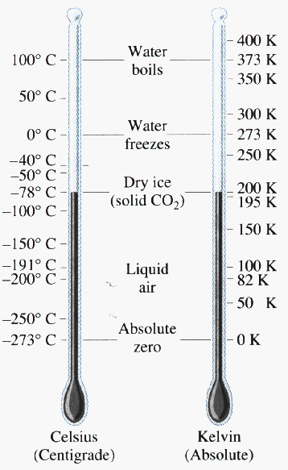
Concept Development
Absolute Zero
As an object is cooled, its particles slow down.
In all objects there exists a temperature at which all movements are the slowest they can possibly be.
This point is called absolute zero, which corresponds to -273.15 °C.
The Kelvin (K) temperature scale is a temperature scale which uses absolute zero as 0.
One kelvin is the same temperature difference as one degree Celsius.
However, the kelvin is not referred to or written as a degree.

